Slide 1
Simulation and Modeling
Lecture 01 & 2
Introduction
Muhammad Mahbub Alam, PhD
Professor
CSE Department, IUT
20/04/2021

Slide 2
Course Objectives
To be able to build the model of a system
Simulation model of a discrete event system
To be able to develop the simulation program
Using a general purpose language, C++
To be able to analyze the simulation output
Understand the desired characteristics of the target system

Slide 3
Text Books
Simulation Modeling and Analysis
Averill M Law
Discrete-Event Simulation: A First Course
Lawrence Leemis, and Steve Park
Discrete-Event System Simulation
J Banks, JS Carson, BL Nelson, and DM Nicol
Introduction to Discrete Event Systems
C G Cassandras, and Stephene Lafortune

Slide 4
Simulation, Modeling and Analysis
Simulation
Imitation of the operation of a system or process
Generate an artificial history of running the system
Modeling
An Alternate representation of the system physically or mathematically
Performance Evaluation
Understanding the behavior of the system
By analyzing the artificial history
Inference of the operational characteristics

Slide 5
Performance Evaluation

Slide 6
Experiment with Actual System/Model
Actual System
Best to experiment with actual system
No question of validity
Rarely feasible to work
Too costly or too disruptive
E.g., reducing the # of tellers of a bank
Actual system might not exist
Behavior of proposed alternatives
System might not be accessible
Vulnerable to work with
Too secured

Slide 7
Experiment with Actual System/Model (Contd.)
Model of a system
A representation of the real system
Usually, real systems are too complex
Difficult to represent
A # of assumptions/simplifications are made
Assumptions should be reasonable
Otherwise, the model might not represent the target system
Validation of the model is required

Slide 8
Physical Model/Mathematical Model
Physical Model
A replica of the real system
At least the necessary components of the system
Components associated with the evaluation
Cockpit of a airplane used for pilot training
Might not suitable for many systems
A communication device is too costly to build
An IC cannot be made just for testing
Though, a fast food restaurant might be replicated in a warehouse

Slide 9
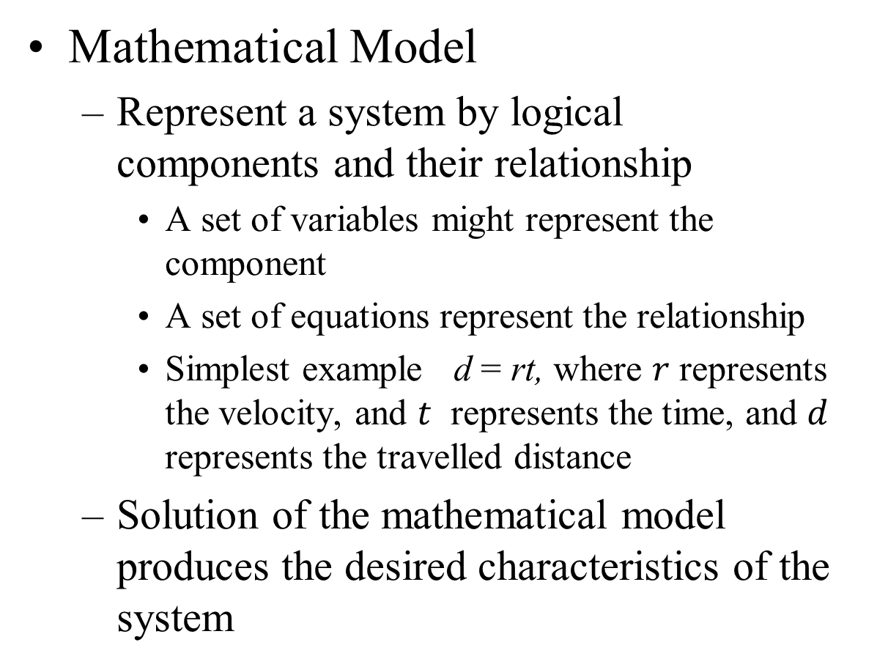
Physical Model/Mathematical Model (Contd.)
Mathematical Model
Represent a system by logical components and their relationship
A set of variables might represent the component
A set of equations represent the relationship
Simplest example d = rt, where $r$ represents the velocity, and $t$ represents the time, and $d$ represents the travelled distance
Solution of the mathematical model produces the desired characteristics of the system

Slide 10
Analytical Solution/Simulation
Analytical Solution
Quantity of interest are found by analytically solving the model
Easy for simple model
t = d/t
Complex system might require vast computing resources
A close-form solution might not exist
If analytical solution is available and computationally efficient
preferred over simulation

Slide 11
Analytical Solution/Simulation (Contd.)
Simulation
Numerical techniques are used to evaluate the system
Imitate the behavior of the real system
For a set of inputs, a set of outputs are generated
System behavior is studied from the output data
Difficult to distinguish whether an observation represents the system interrelationship or just a random result

Slide 12
When Simulation is Appropriate
To know the internal interaction of a complex system
To know the information, organizational and environmental changes
To experiment with new systems
proposed extension of a system
To verify the analytical solution

Slide 13
When Simulation is not Appropriate
The problem can be solved by common sense
The problem can be solved analytically
Direct experiment can be easily performed
The cost exceeds the saving
Resources and time are not available
Sufficient data are not available
System’s behavior is too complex

Slide 14
Advantages of Simulation
Explore the following without disrupting the systems
New policies, operating procedures
Decision rules, information rules
Following can be tested
New hardware design, physical layout
Transportation systems
Communications protocols and systems
Hypothesis about how or why certain phenomena occur can be understood
‘What if’ questions about a system can be answered
Especially for new systems

Slide 15
Disadvantages of Simulation
Model building requires special training
Two models of same system unlikely to be same
Packages with model are developed by the vendors
Simulation results can be difficult to interpret
Simulation package includes output data analyzer
Modeling and analysis can be time consuming
Advances in hardware and simulation packages made it faster
Using simulation instead of an analytical solution most of the cases
Closed form solution for most systems are not possible

Slide 16
Areas of Application
Manufacturing applications
Semiconductor manufacturing
Construction of engineering and project management
Military applications
Logistics, supply chain, and distribution applications
Transportation modes and traffic
Business process simulation
Health care

Slide 17
Systems – Qualitative Definition
An aggregation of things to form an integral or complex whole (Encyclopedia of Americana).
A regularly interacting or interdependent group of items forming a unified whole (Webster’s Dictionary)
A combination of components acting together to perform a function not possible with any of the individual parts ( IEEE Standard Dictionary).
Salient Features
A system consists of interacting components
A system is associated with a function that it performs

Slide 18
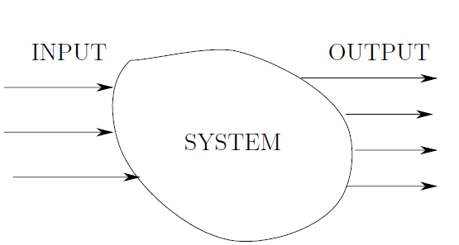
Systems – Quantitative Definition
A quantitative definition associates a set of measurable variables with a system.
By measuring them over time [t₀, t_{f}], the system behavior can be described
Input variables: set of time function that can be controlled
u(t) = [u₁(t), …, u_{p}(t)]^{T} t₀ < t < t_{f}
Output variables: set of variables representing the quantity of interest
y(t) = [y₁(t), …, y_{m}(t)]^{T} t₀ < t < t_{f}

Slide 19
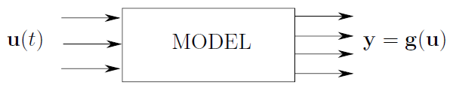
Systems – Quantitative Definition (Contd.)
The quantitative definition of a system represents a model of the system
A model duplicates the behavior of a system
Mathematical relationship between input and output
A set of function defines the input-output relationship
y₁(t) = g₁(u₁(t), …, u_{p}(t)), …, y_{m}(t) = g_{m} (u₁(t), …, u_{p}(t))
The system model in mathematical form
y = g(u) = [g₁(u₁(t), …, u_{p}(t)), …, y_{m}(t) = g_{m} (u₁(t), …, u_{p}(t))]^{T}
Where g(∙) denotes the column vector with entities g₁(∙), g_{m}(∙).
This is the simplest possible modeling process – Input-output modeling

Slide 20
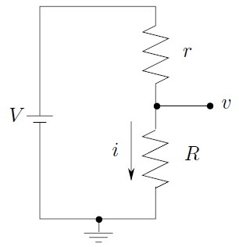
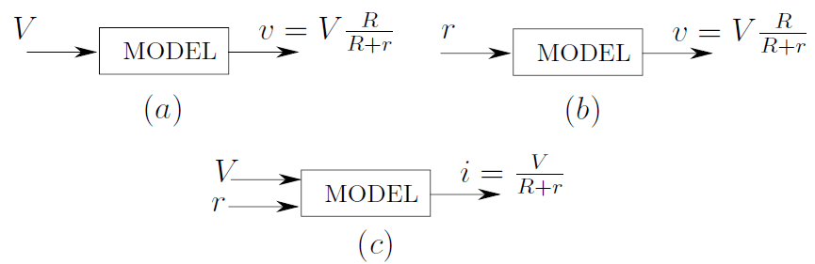
System Model – Example

Slide 21
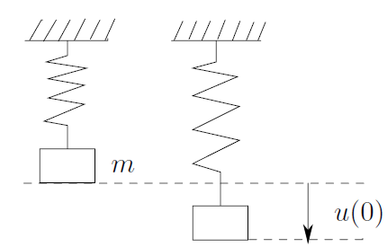
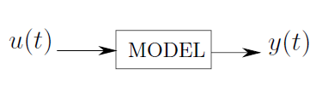
System Model – Example (Contd.)

Slide 22
Static vs. Dynamic System Models
Static System model
Time does not play a role
Input-output relationship are described by algebraic equations
y(t) is independent of past input values
No memory is required
Dynamic System model
It evolves over time
Input-output relationship is described by differential equation
y(t) generally depends on past values of input

Slide 23
Input-Output Model
The Input-Output model is unable to predict the future output y(t) given the u(t) for a dynamic system
Output is a direct function of the current input
Output of dynamic systems is affected by previous inputs
The impact of the past values should be stored in a set of variables
The values of these variables will represent the system state at that time

Slide 24
Model of a Dynamic System
If at t₁, the displacement is y(t₁),
y(t₁+ τ) = ?
Can we uniquely determine y(t₁+ τ) for τ > 0
There are three possibilities
y(t₁+ τ) > y(t₁), the mass moving downward
y(t₁+ τ) < y(t₁), the mass moving upward
y(t₁+ τ) = y(t₁), the mass is at rest
How can we decide one of the above
What information is missing here
The velocity of the mass
The input cannot only determine the output

Slide 25
The concept of State
State of a system at any time describes the behavior of the system at that time in some measureable way
The state of a system at time t₀ is the information required at t₀ to uniquely determine the output y(t), for all t ≥ t₀, given u(t), for t ≥ t₀

Slide 26
State Space Modeling
In addition to input and output variables, a set of state variables, x(t), is defined
Models represent the relationship among u(t), y(t), and x(t).
Reflects the system dynamics
The set of equations required to specify the state x(t), for all t ≥ t₀, given x(t₀) and the function u(t), t ≥ t₀, are called state equations
The state space of a system, X, is the set of all possible values that the state may take.

Slide 27
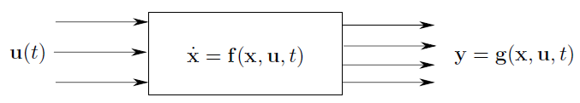
State Space Modeling (Contd.)
State equations of a system usually depend on the system, however, it might have the following form
The state space model needs to specify the following set of equations

Slide 28
Input-output vs. State Space Modeling
Input-output Modeling
Black-box approach
System behavior is captured by observing the output response to an input
Internal structure is unspecified
State Space Modeling
States of the system are identified
A set of state equations are derived
System dynamic is captured
Output variables are chosen based on interest
Output variables are calculated for different input conditions

Slide 29
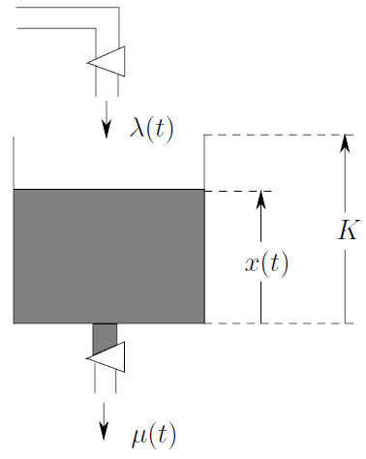
State Space Model: Example
λ(t) – rate at which flow in
μ(t) – rate at which flow out
x(t) – desirable fluid level, and the state variable
0 ≤ x(t) ≤ K, t ≥ 0
Complete state equation
The complete model is
u₁(t) = λ(t) and u₂(t) = μ(t) are the input variables
y(t) = x(t) is the output variable

Slide 30
Thank You

